Slide 1
Webinar emission calculation
09.03.2023 HOW TO BEST IMPLEMENT A CO2 EMISSION CALCULATION TOOL?
Agenda
Introduction Evert de Jong (ECTA)
FAQ’s and Questions from the participants Michael Vetter (Bertschi) Bernhard Haidacher (LKW Walter) Luke van der Bunt (Den Hartogh)
Follow Up

Slide 2
Webinar emission calculation
Meeting rules
Do’s and dont’s – no commercial contents, reminder of EU Competition Law requirements
Because of the high number of participants, we request all (except for the speakers / panel members) to communicate via the chatbox of the meeting.
Please all mute your microphones and block your cameras to facilitate a smooth meeting and ensure the best connectivity during the meeting.

Slide 3
Zero emission knowledge platform
Webinar Plan 2023:
09.03.2023 HOW TO BEST IMPLEMENT A CO2 EMISSION CALCULATION TOOL? (presented by ECTA/EdJ with panel members Bertschi, Den Hartogh, LKW Walter and with Guest Speaker of Chem.Prod.)
xx.06.2023 How to prepare as carrier for the green deal directive xxx that becomes applicable in transport on xxx? (presented by Talke)
12.10.2023 (presenters to be defined) A. Basic cleaning and warehousing emission calculation OR B. How to get initiatives in action and how to improve? “Getting emissions down” OR C. Panel about intermodal shifts experts (chemical industry) Your Choice

Slide 4
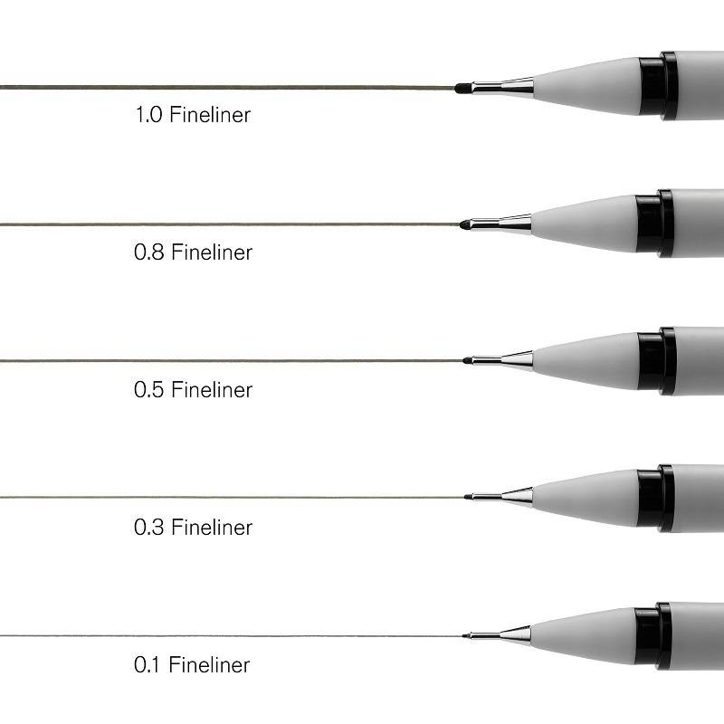
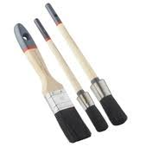
Webinar emission calculation
2000 ..................................................................................................................... 2030

Slide 5
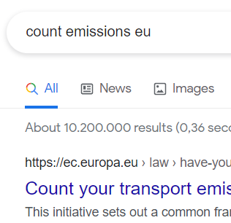
Webinar emission calculation
2011 Prof. Alan McKinnon – Cefic/ECTA Guidelines Emission Calculations
2012 ECTA RC KPI Form, including excel emission calculation tool
2021 GLEC Module 5
2022 SQAS Chapter 9 TS/TC/WH
2022 ECTA KPI Form for 2021 data reporting
2023 ISO 14083
2023 EU DIRECTIVE ‘COUNT EMISSIONS EU’
2023 CEFIC/ECTA BEST PRACTICE GUIDELINE

Slide 6
Webinar emission calculation
2020 RC Workshop presentation EcoTransit Christian Kollenberg with practical examples
2020 RC Workshop presentation SFC Folkert Bloembergen
2021 RC Workshop presentation* BERTSCHI Michael Vetter
2021 RC Workshop presentation* LKW WALTER Bernhard Haidacher
2022 RC Workshop presentation* HOYER Thies Grage * included in the ECTA Platform library

Slide 7
2020 SFC presentation cuts

Slide 8
2020 SFC presentation cuts

Slide 9
2020 ecotransit presentation cuts

Slide 10
2020 ecotransit presentation cuts

Slide 11
2020 ecotransit presentation cuts

Slide 12
Webinar emission calculation
TMS
FINANCIAL DATA
ORDERS
CONTRACTS
DATABASE KM’S
TRUCK DATA
ORDER EXECUTION
EMISSIONS FACTORS
SCOPE 1, 2 AND 3
SUBCONTRACTOR DATA ROAD/INTERMODAL
Primary / secundary data: ask the panel!

Slide 13
Webinar emission calculation
Your options:
Create your own simple measuring tool
Let your IT department develop your own tool, and start compiling your own database with distances, emission factors
Buy an existing software package and let it be linked to your TMS
Recommendation made during the 2022 RC Workshop

Slide 14
Webinar emission calculation
What do your customers have as minimum requirements:
Compliance with legal requirements, compliance with SQAS defined requirements
Uniformity and traceability to standard requirements, in compliance with GLEC
What your system should produce as a minimum:
See above
Emission totals per order, per customer, in total for your company

Slide 15
Webinar emission calculation
Please remember that your carbon footprint does not only exist of tonkilometers x emission factor, you must also link your data to:
Empty kilometers
Extra kilometers for tank cleaning, maintenance and repairs, personal driver kilometers

Slide 16
CO2 Footprint – Customer perspective
Situation
Currently no auditable, industry wide implemented mechanism to report & measure CO2 footprint of our Logistics Supply Chain
Complication
No effective mechanism to track progress & performance of suppliers
Question:
Will ECTA design & implement such a mechanism or wait on their customers to develop a solution for them?

Slide 17
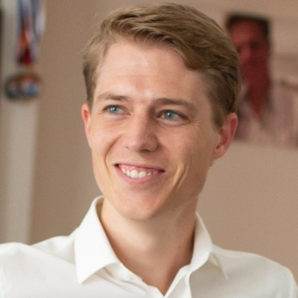
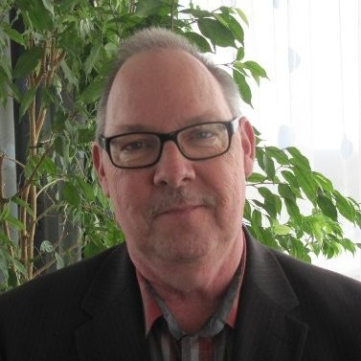
Webinar emission calculation
FAQ’s and Questions from the participants: our panel
Michael Vetter (Bertschi)
Bernhard Haidacher (LKW Walter)
Luke van de Bunt (Den Hartogh)
Evert de Jong (ECTA), moderator

Slide 18
Webinar emission calculation
Thanks for your participation in this webinar.
May I also bring to your attention:
Please share your remaining questions also at our ZERO EMISSION KNOWLEDGE PLATFORM
FORUM

